Slide 1

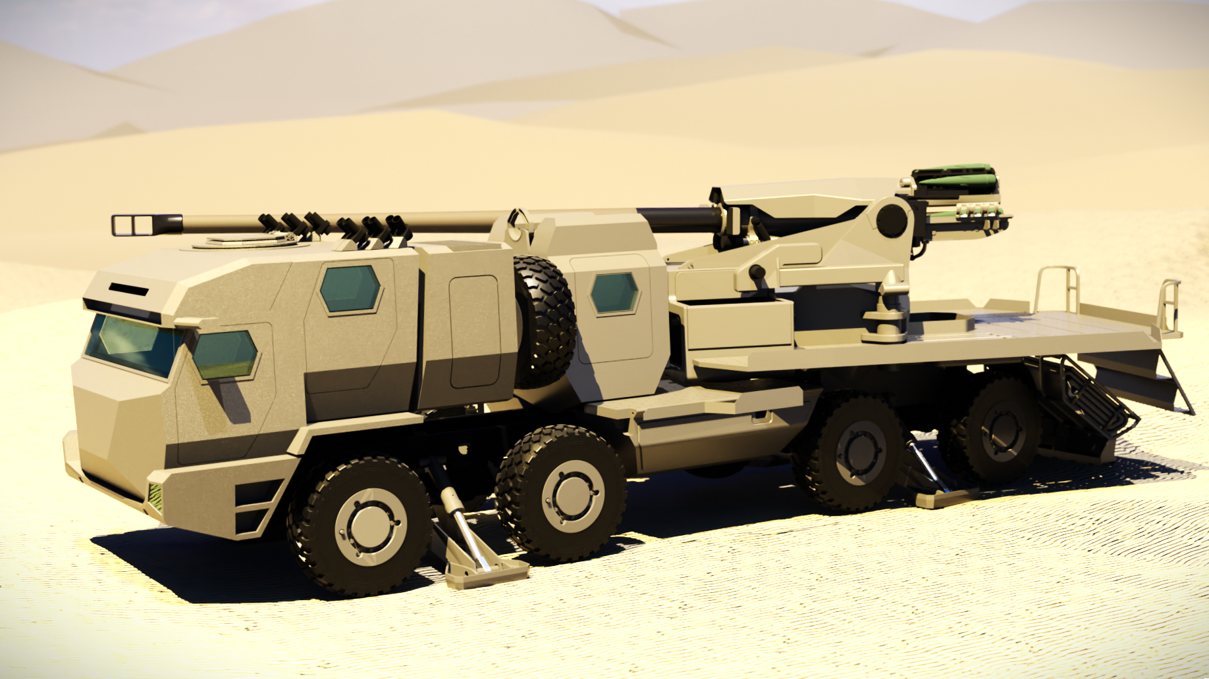
PROJECT LAHAB

Slide 2
Date: 29 May 24
RESTRICTED
Project LAHAB
Agenda for Visit to HIT (Visit no 2 for 2024)
1 of 4

Slide 3
Senior Management Meetings
Agenda Points
No | Agenda Point | For Discussion | Remarks
 | a | b | c
1 | FBL Establishment Deliverable List | Vehicle Test Report as Deliverable? TATRA Responsibility? | Contract Deliverables
2 | ABL Establishment Deliverable List | Confirm Deliverable List Remedy Schedule
3 | Over-all Program Progress | Master Program Schedule Sub- Projects Risk Register | Technical Performance Measurement
4 | Dedicated Skills Upliftment Management Structure | a. Identify specific responsibilities
5 | Skills Upliftment Program | Program Visits to HIT for 2024 Detail activities in preparation of Visits | Skills Upliftment Program Management Plan
2 of 4

Slide 4
Senior Management Meetings
Agenda Points
No | Agenda Point | For Discussion | Remarks
 | a | b | c
6 | Communication protocol Program Management Meetings / IPT / JPRC / JDC Meetings | Meeting Schedule. Roles and Responsibilities. Mandates | Meeting Agendas
7 | Junior Engineers prolonged visits to South Africa | Identify Engineering functional fields. Agree on individual contribution to Program Deliverables. | In formal: co-worker principle
8 | Manufacturing Plan Details | Details regarding Manufacturing Schedule. Manufacturing processes | Explisign and HIT Presentation
9 | CFE Delivery Schedule | a. Progress Status
3 of 4

Slide 5
Senior Management Meetings
Agenda Points
No | Agenda Point | For Discussion | Remarks
 | a | b | c
10 | Configuration and Data Management | Document Approval Process TAC process | Track Changes versus OAR / COAR
11 | ILS Analyses Software | RELEX, EDCAS etc. | LSA Database establishment Requirements
12 | Joint Project Review Committee Meeting (JPRC) | Agenda for meeting to be finalised by Meeting Secretariat HIT Secretariat to be appointed | Scheduled 07 June 24 Confirmed Agenda point for discussion a. Feedback to Chairperson and CTO on Program Progress
4 of 4

